Slide 1

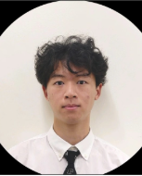


ECE 477 Final Review: Team #15
Brian Lu Systems Lead
Caleb Shinkle Software Lead
Seth Deegan Team Lead
Nathan Huang Hardware Lead

Slide 2
Outline
Project Overview
Block Diagram
Design Challenges
Individual Contributions
Project Video Demonstration
Questions

Slide 3
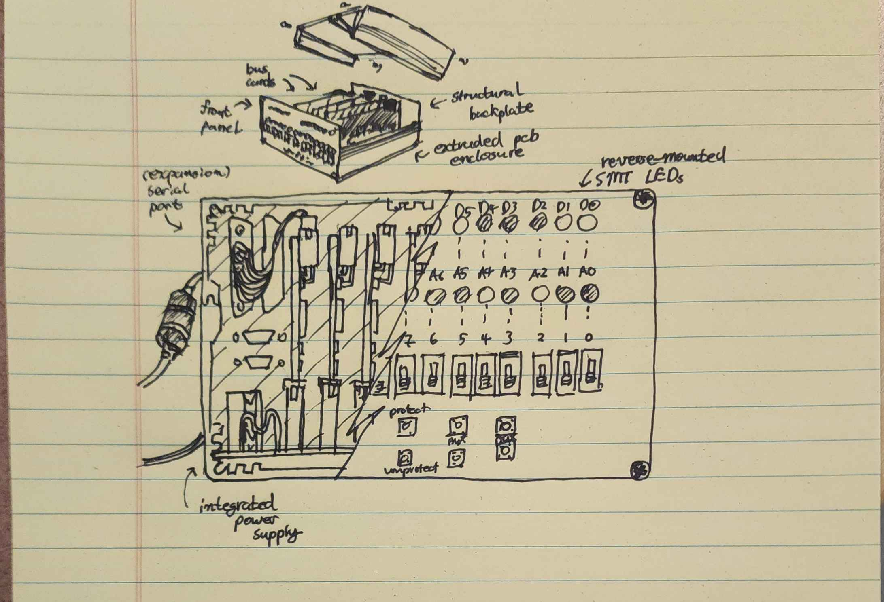
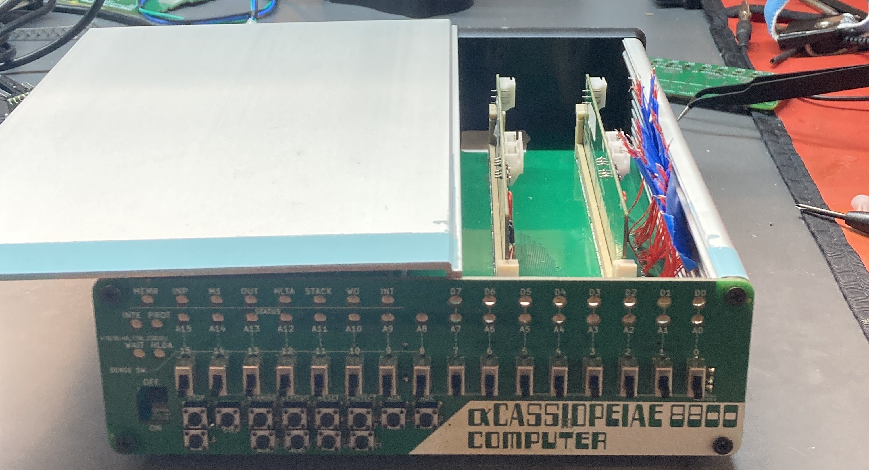
Project Overview
Our project is a miniaturized version of the Altair 8800, the first commercially successful personal computer from MITS in 1974. It is an actual microcomputer that can be programmed from its front switches.
Artist Rendition
Final Product

Slide 4
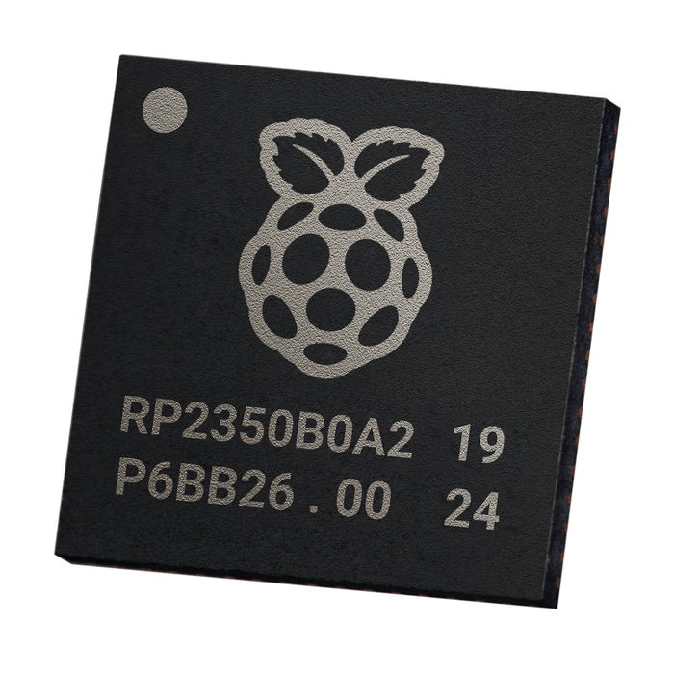

Project Overview (Hardware)
Our project differs from the original Altair 8800 by:
Emulating the functionality of the original hardware
RP2350B microcontrollers housed on custom PCBs
All software written in Rust
Using modern bus voltages
All logic on 3.3V as opposed to +/- 16V, +/- 8V, etc.
Reducing the form factor
More condensed/portable

Slide 5
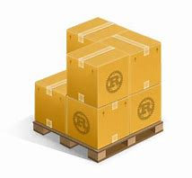
Project Overview (Software)
We ended up using 3 major software packages for our final design:
Interchange: Front Panel Software
Polls all buttons/switches on front panel, forwards appropriate information to the bus
​Cycle: Intel 8080 CPU Emulator
Listens to bus signals, communicates with memory, and emulates all instructions in the 8080's instruction set
Recall: RAM Software
Listens for and responds to memory requests on the bus
​
Each of these packages runs on its own microcontroller, and they communicate over a 44-signal bus facilitated by a backplane PCB
The packages control GPIO pins to communicate with each other

Slide 6
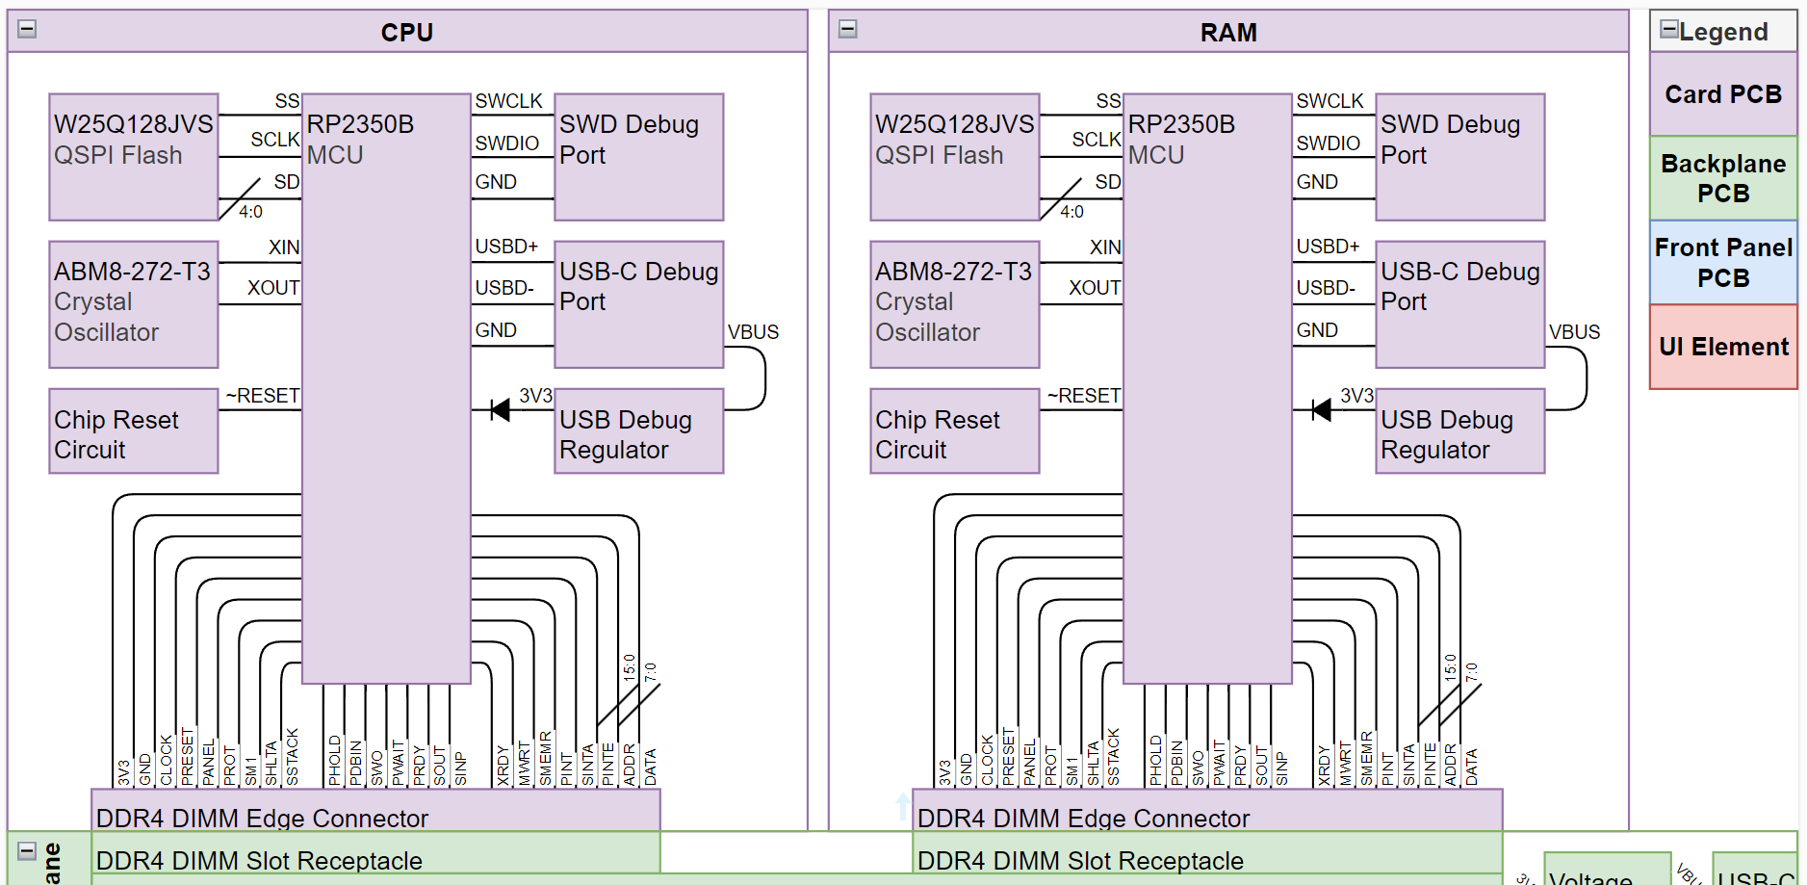
Block Diagram (Cards to Backplane)

Slide 7
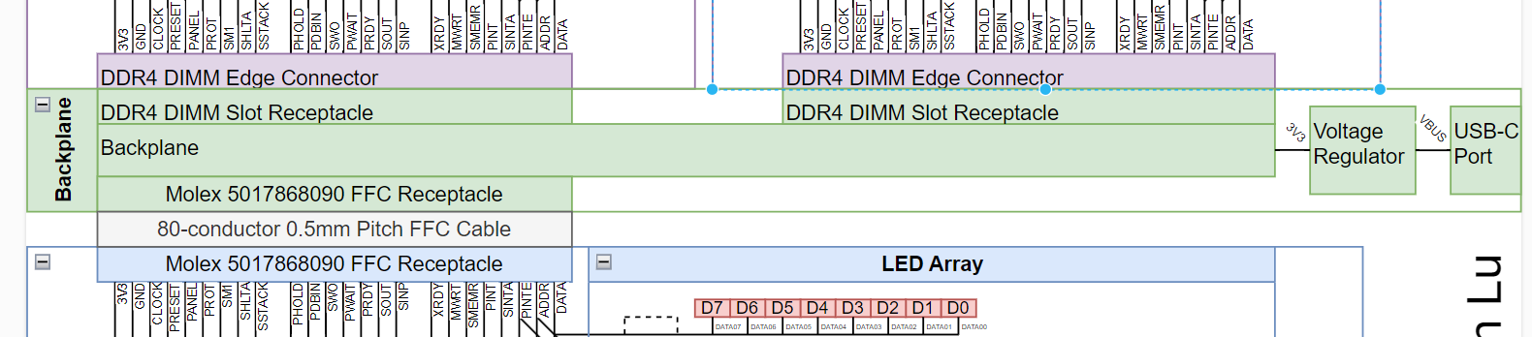
Block Diagram (FUll Backplane Interface)
Card PCBs (CPU, RAM, etc.)
Front Panel

Slide 8
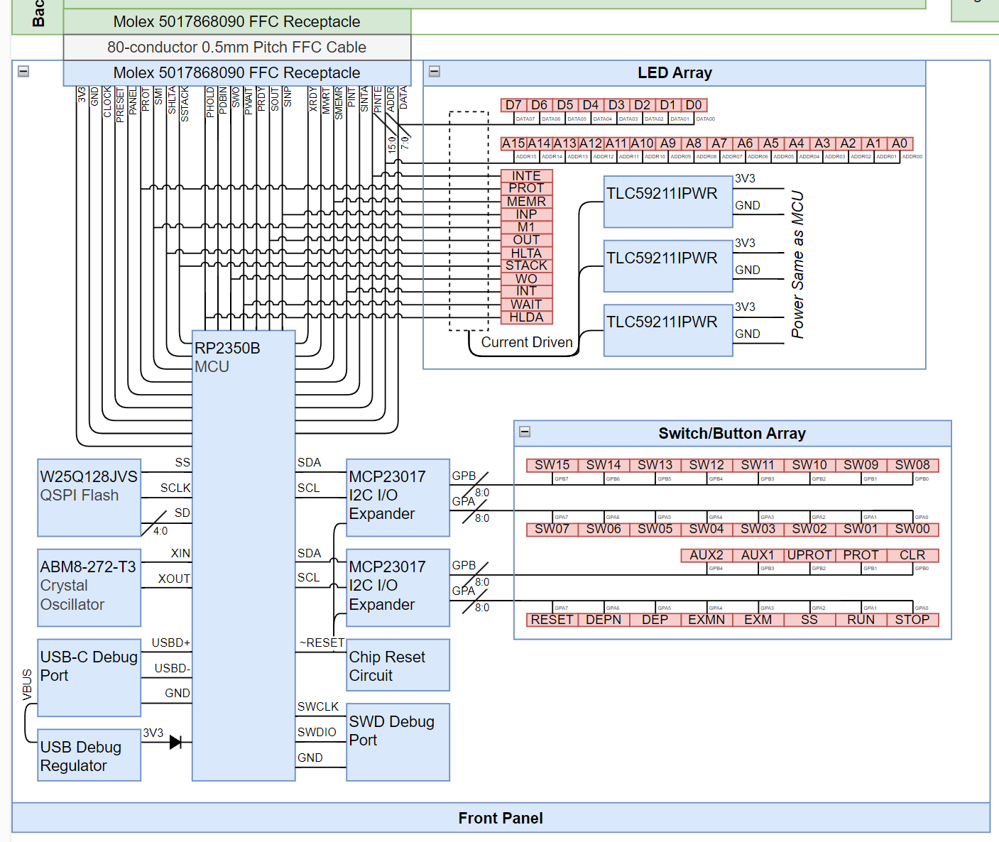
Block Diagram (Front Panel to Backplane)

Slide 9
Design Challenges
Hardware
KiCad 8.0.0 → 9.0.0 → 8.0.0 (backport)
Dense routing requirements for front panel
Flipped QSPI Connections
Improper Solder Paste
Sink Driver Chips
Incorrect Button Pins
Software
Programmable I/O
Debugging Frameworks
Immature Rust tooling
CPU ⇔ RAM Bus Communication

Slide 10
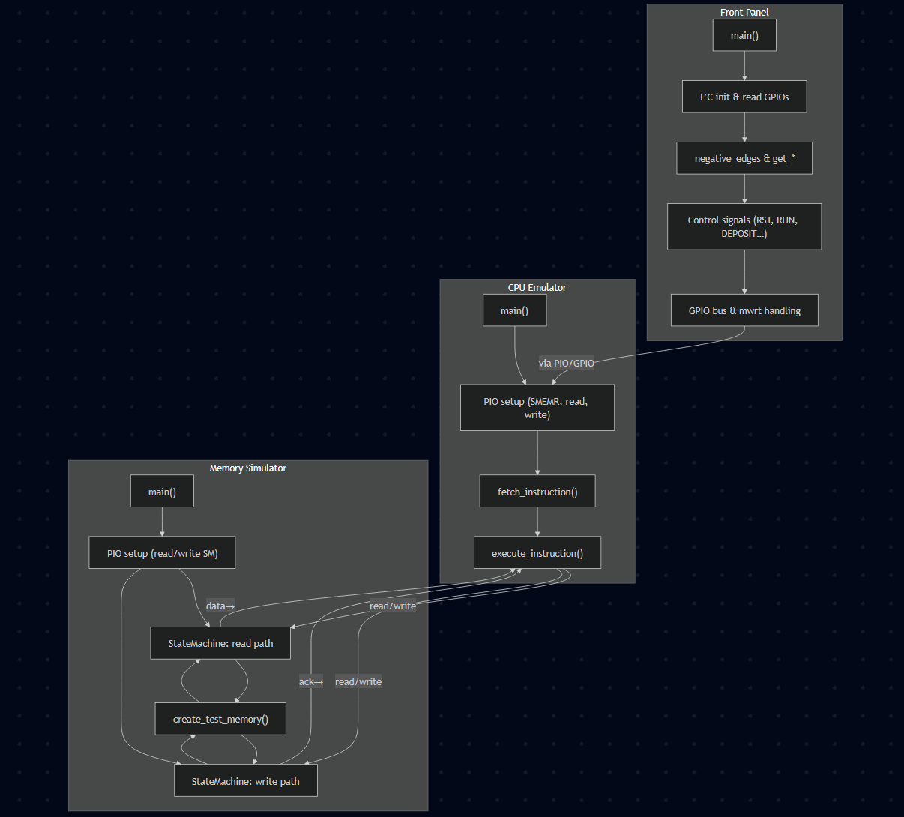
Individual contributions
Seth Deegan
Bus read/write transaction logic and code
Front panel logic and code
Learned and applied Rust RP2350 programming framework, Embassy
Learned and applied probe-rs, OpenOCD debugging tools
Created team bus transaction chart, Gannt chart, documentation
Notes:
<TO-DO>

Slide 11
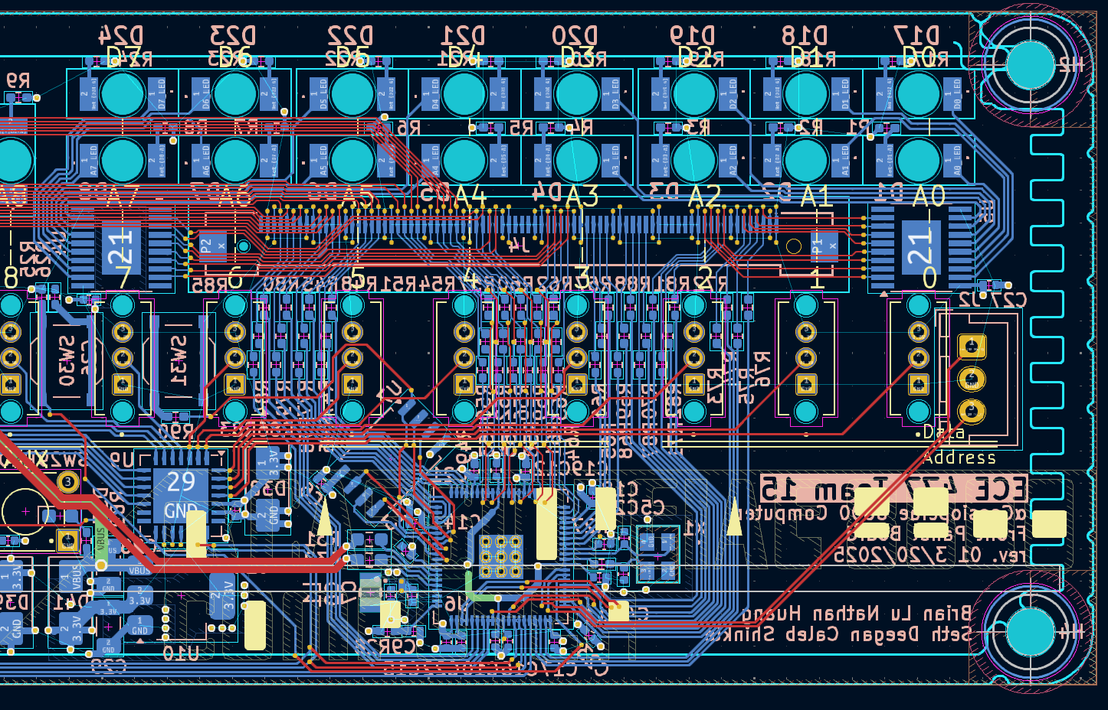
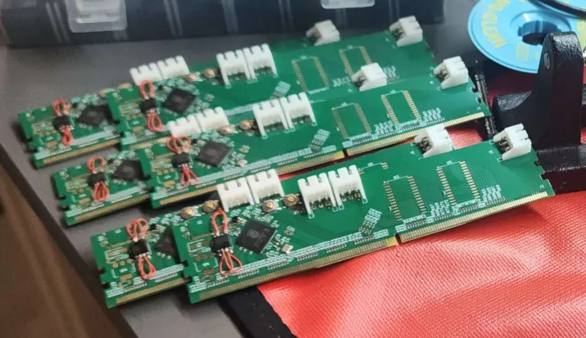
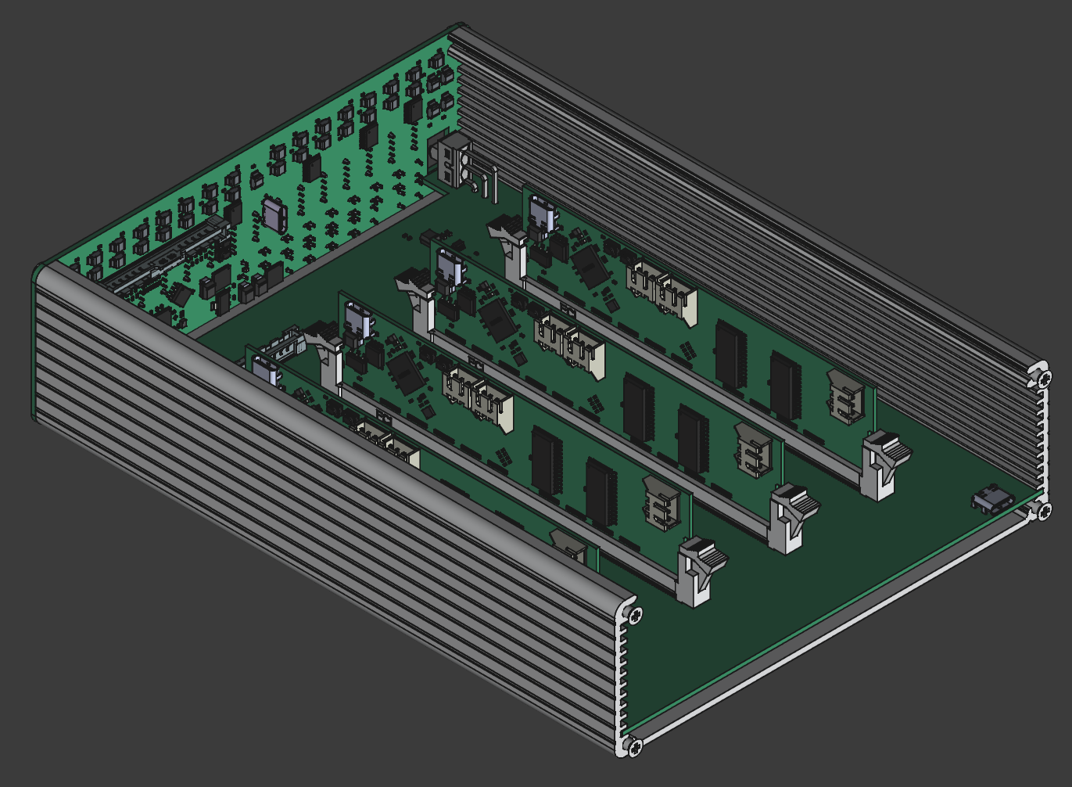
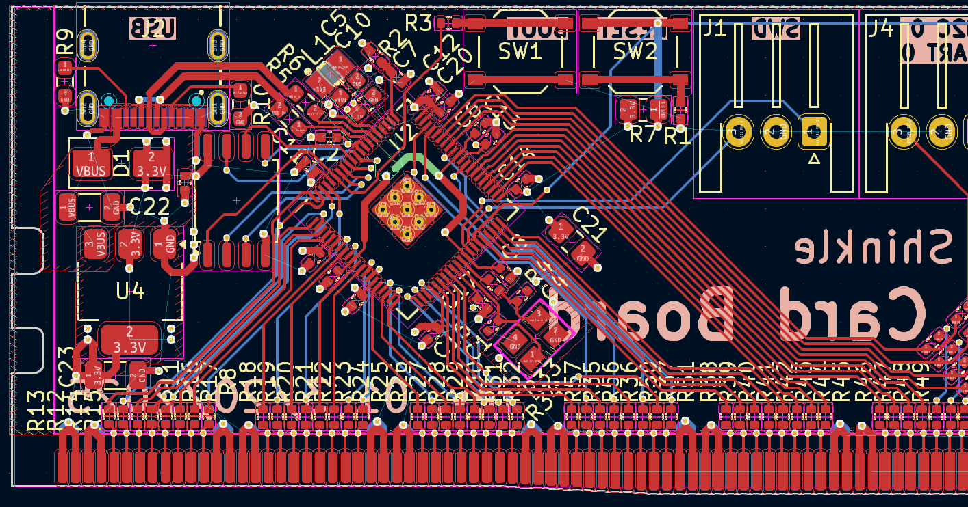
Individual contributions
Brian Lu
Initial project proposal and general system design
Wire harnessing of initial breadboard prototype
Design of microcontroller section and final layout/route of card and front panel PCBs
Mechanical integration of PCBs into pre-defined enclosure
PCB assembly and bodges
Microcontroller bringup
Some software tooling
Assistance on software debugging and memory transaction routines
Notes:
<TO-DO>

Slide 12
Individual contributions
Nathan Huang
Hardware Prototyping
PCB Design
PCB Manufacturing
PCB Assembly & Soldering
Mechanical Design

Slide 13
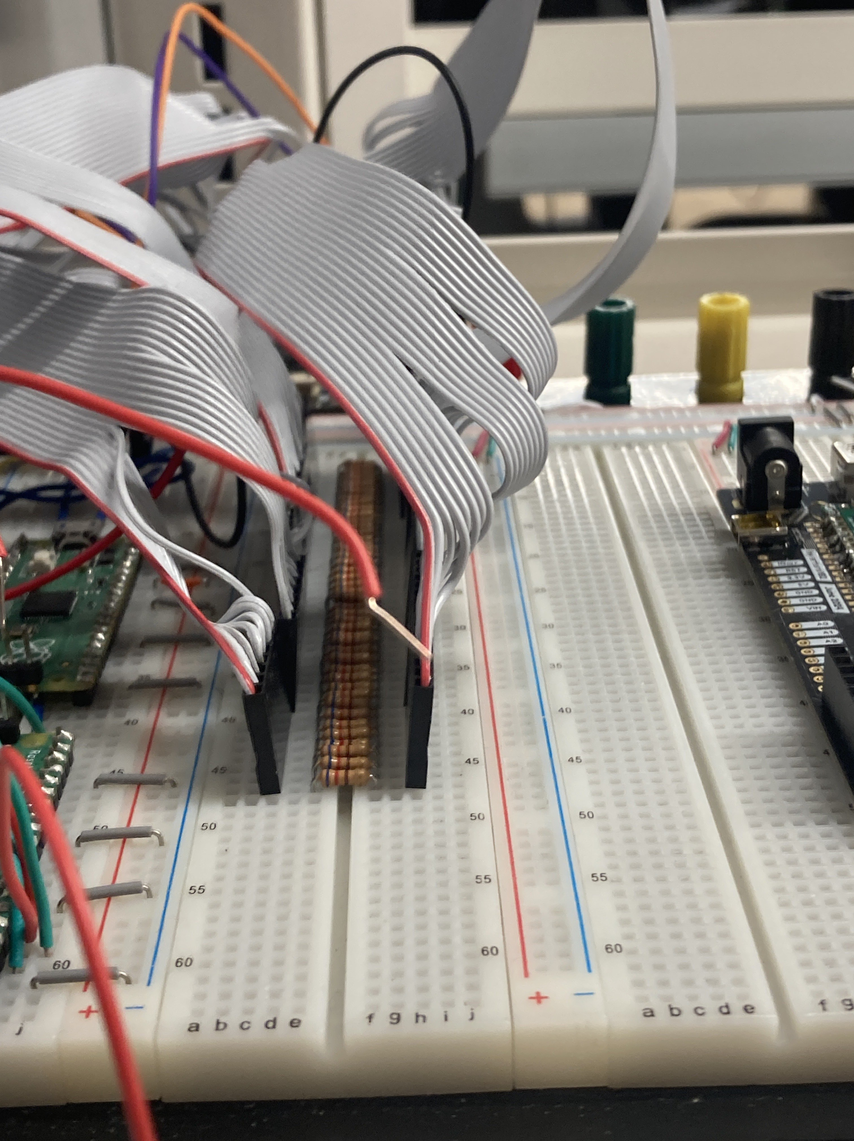
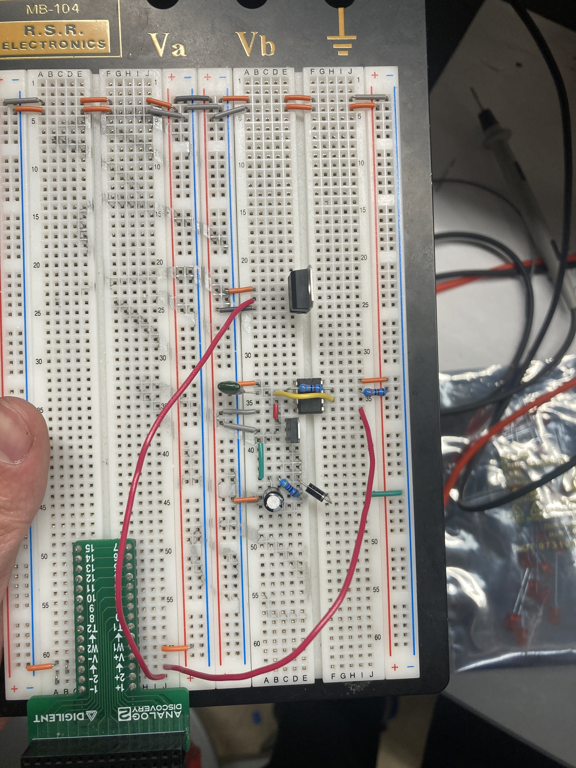
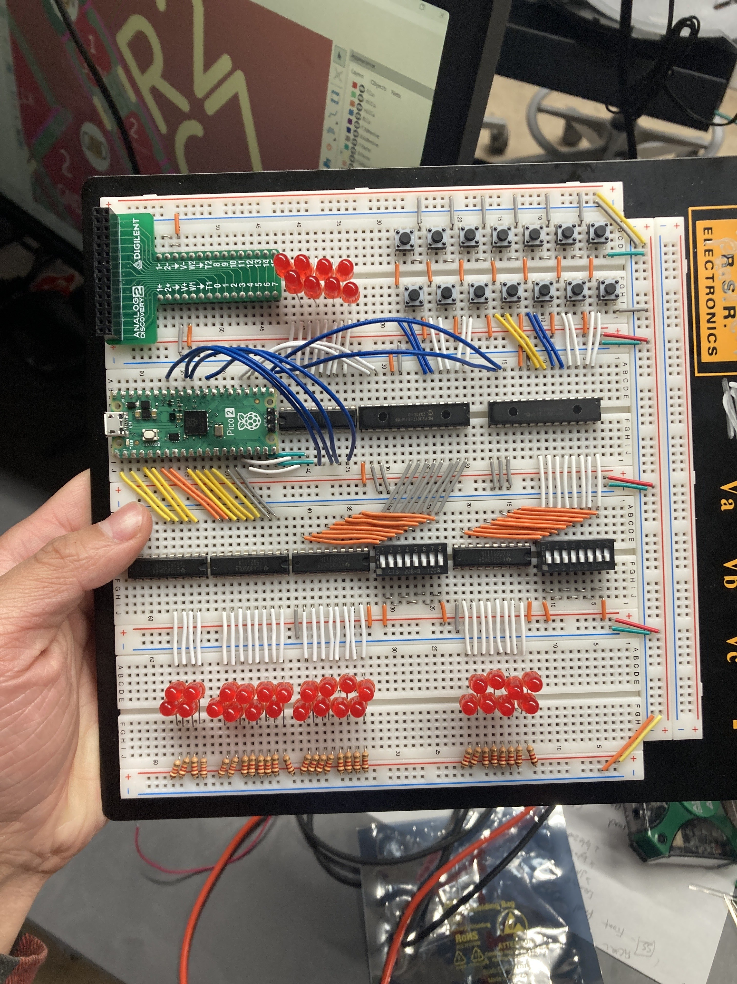
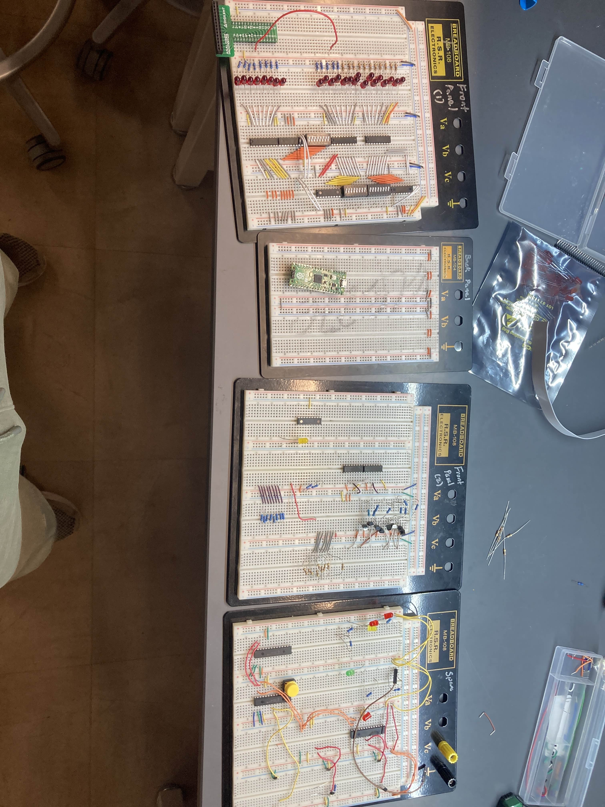
Individual contributions
Nathan Huang
Hardware Prototyping
Front Panel + Redesign
Backplane
Card

Slide 14
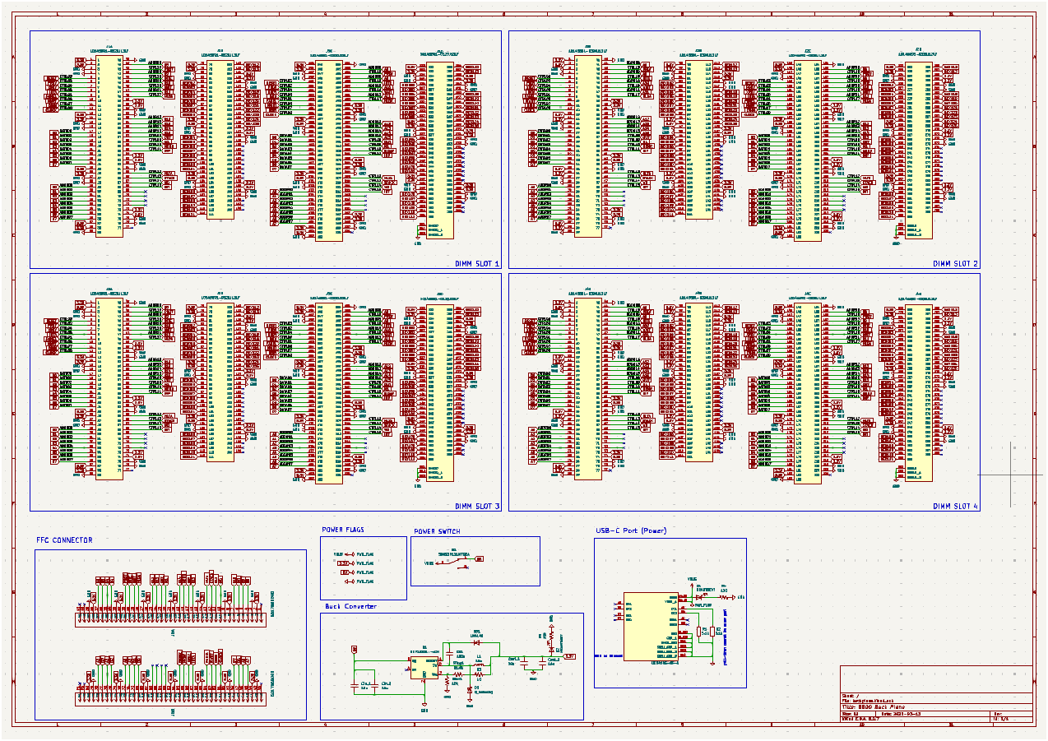
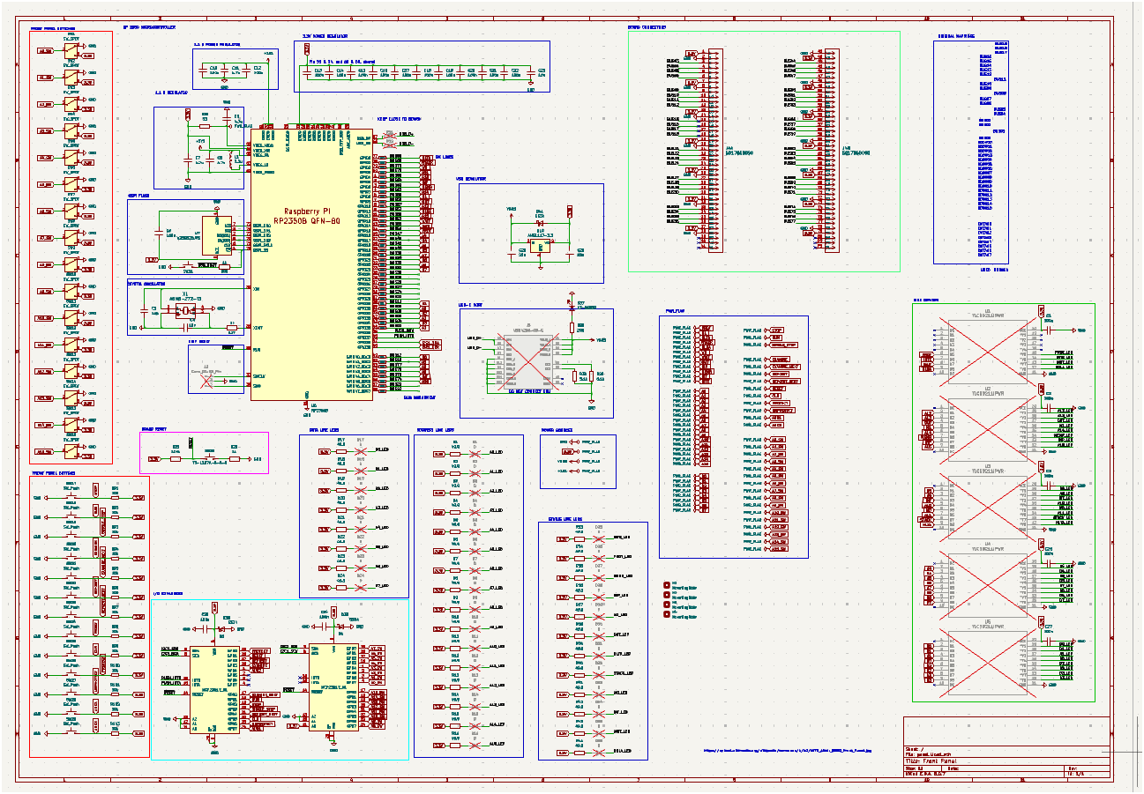
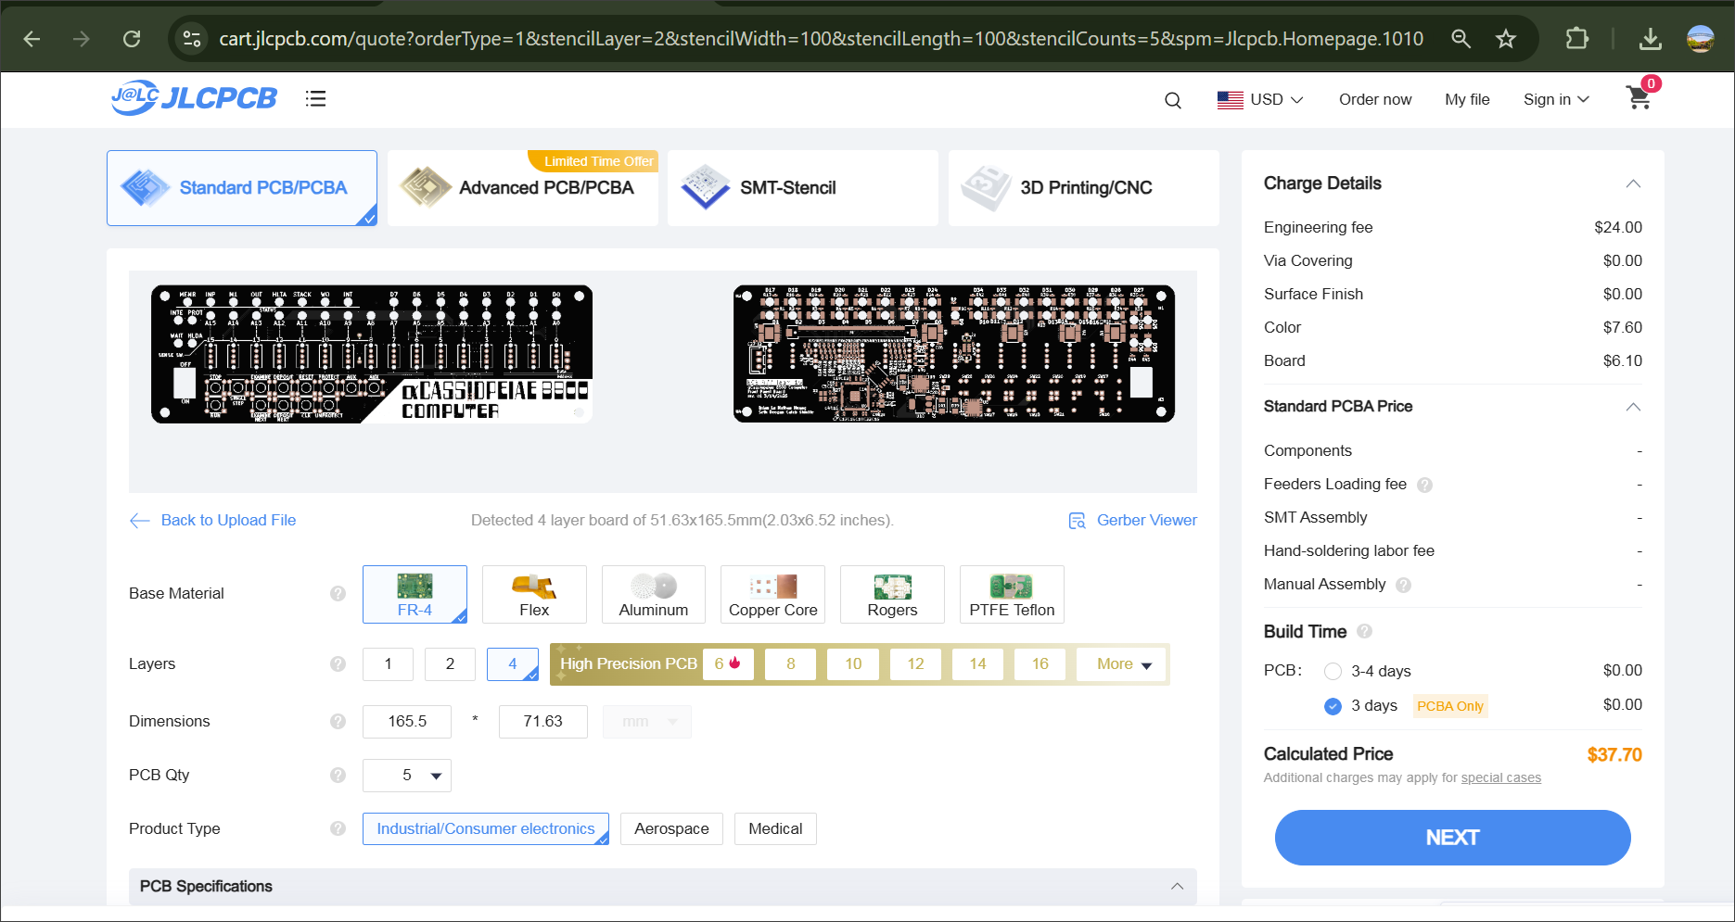
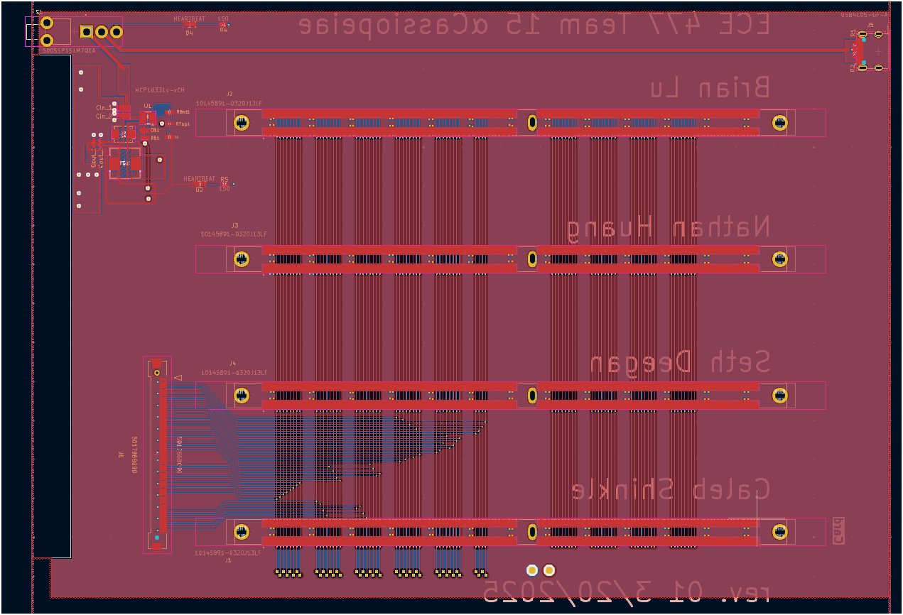
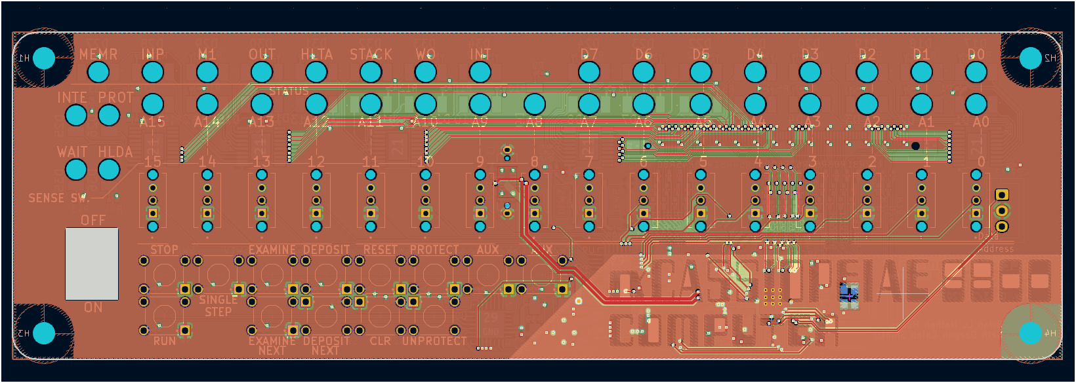
Individual contributions
Nathan Huang
PCB Design
PCB Manufacturing
Back Plane
Front Panel

Slide 15
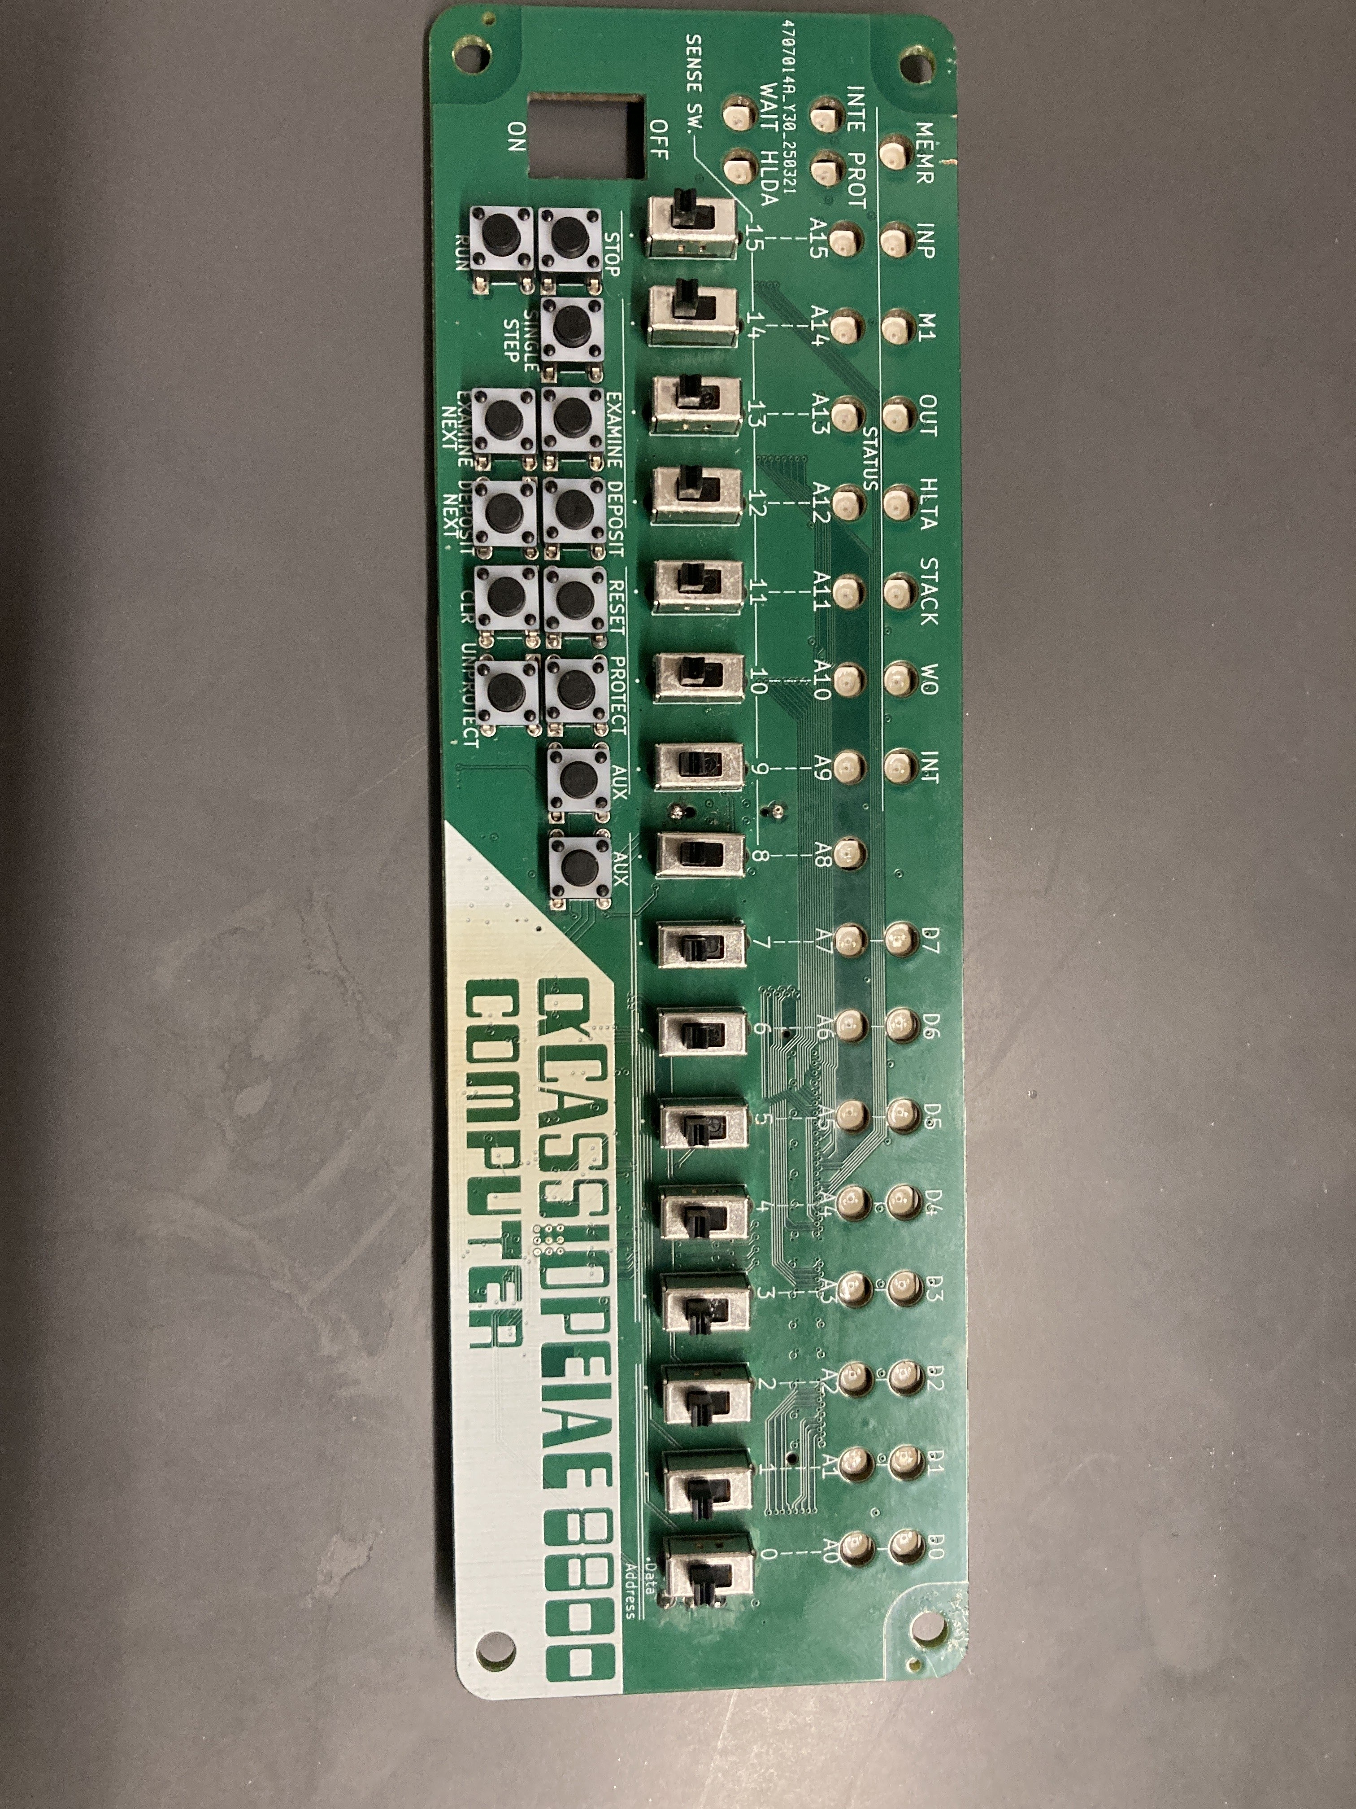
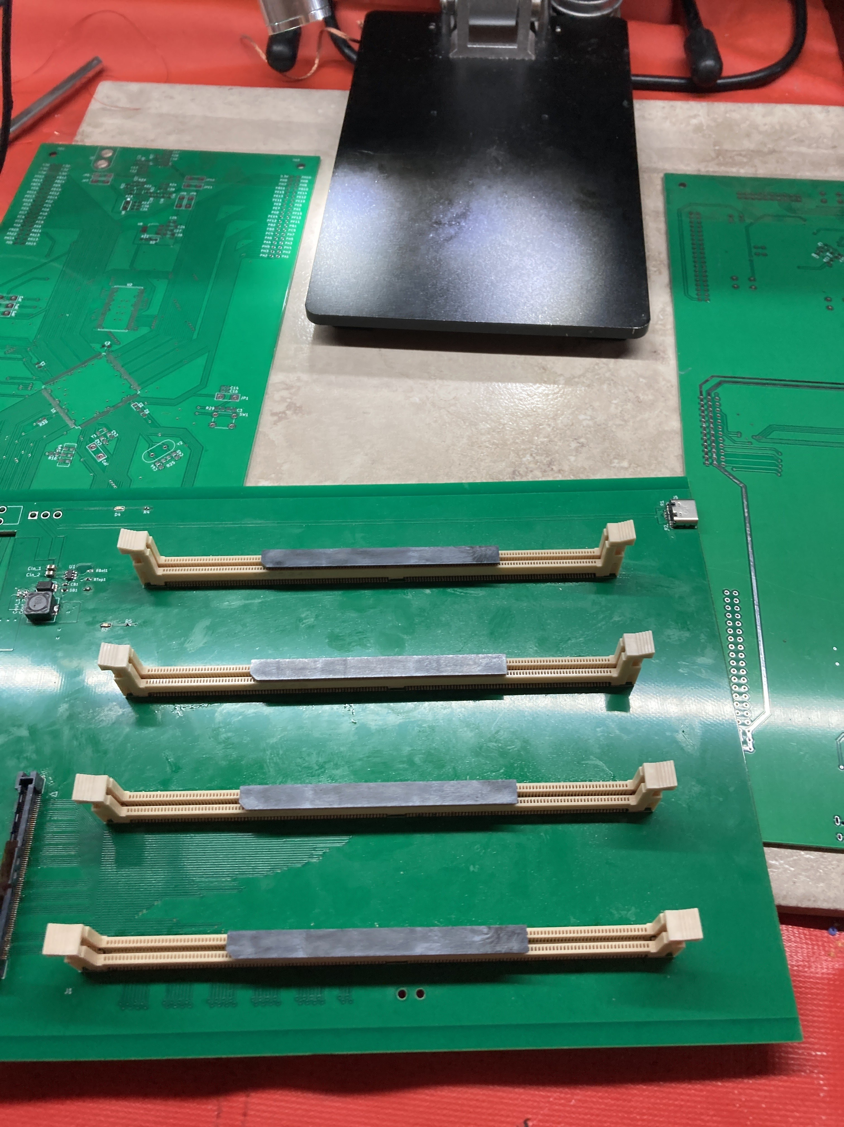
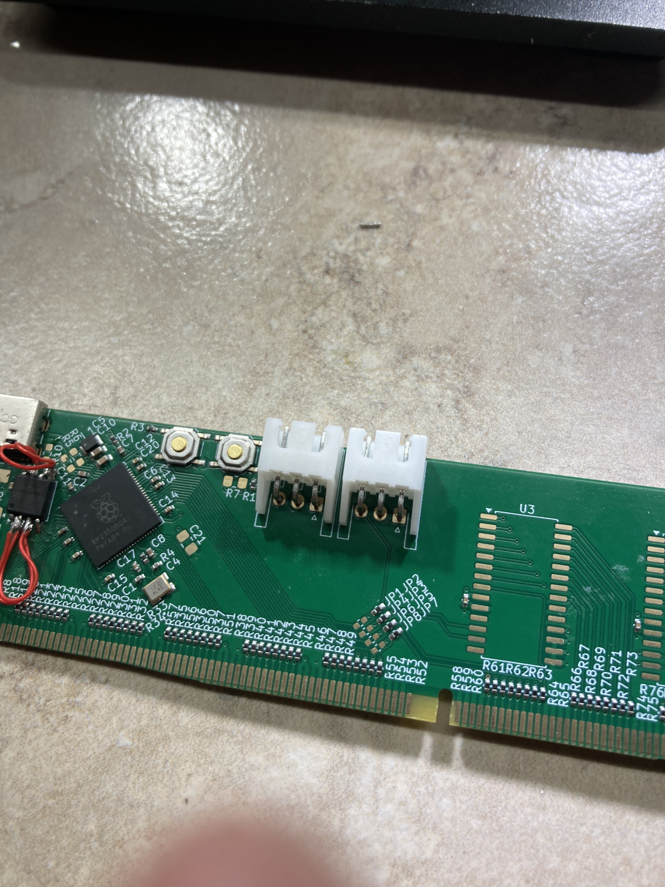
Individual contributions
Nathan Huang
PCB Assembly & Soldering
3 Cards (x4)
1 Backplane (x4)
1 Front Panel (x4)

Slide 16
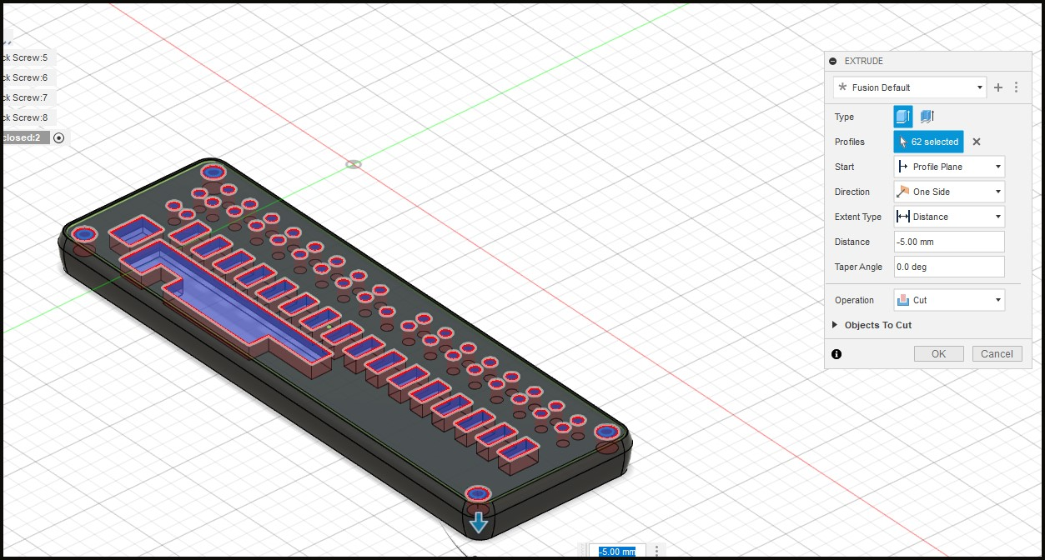
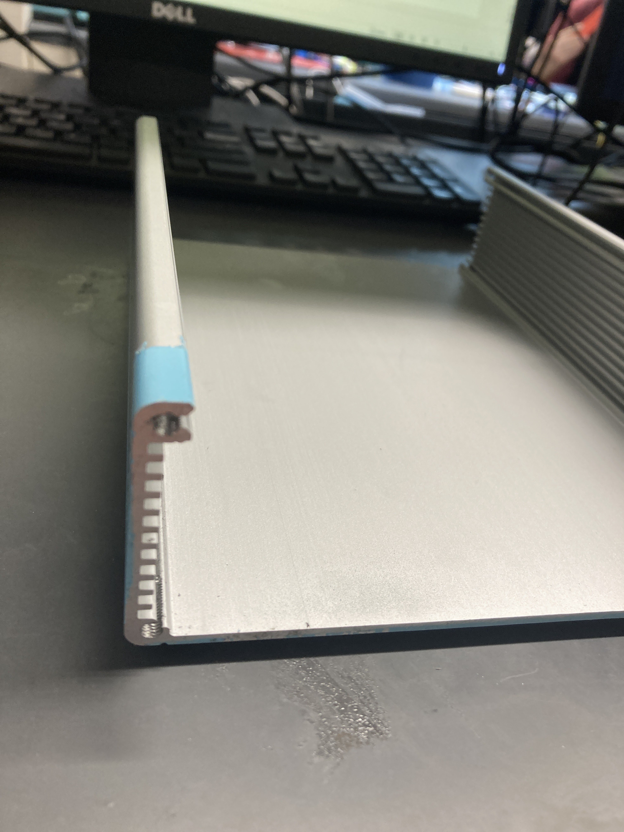
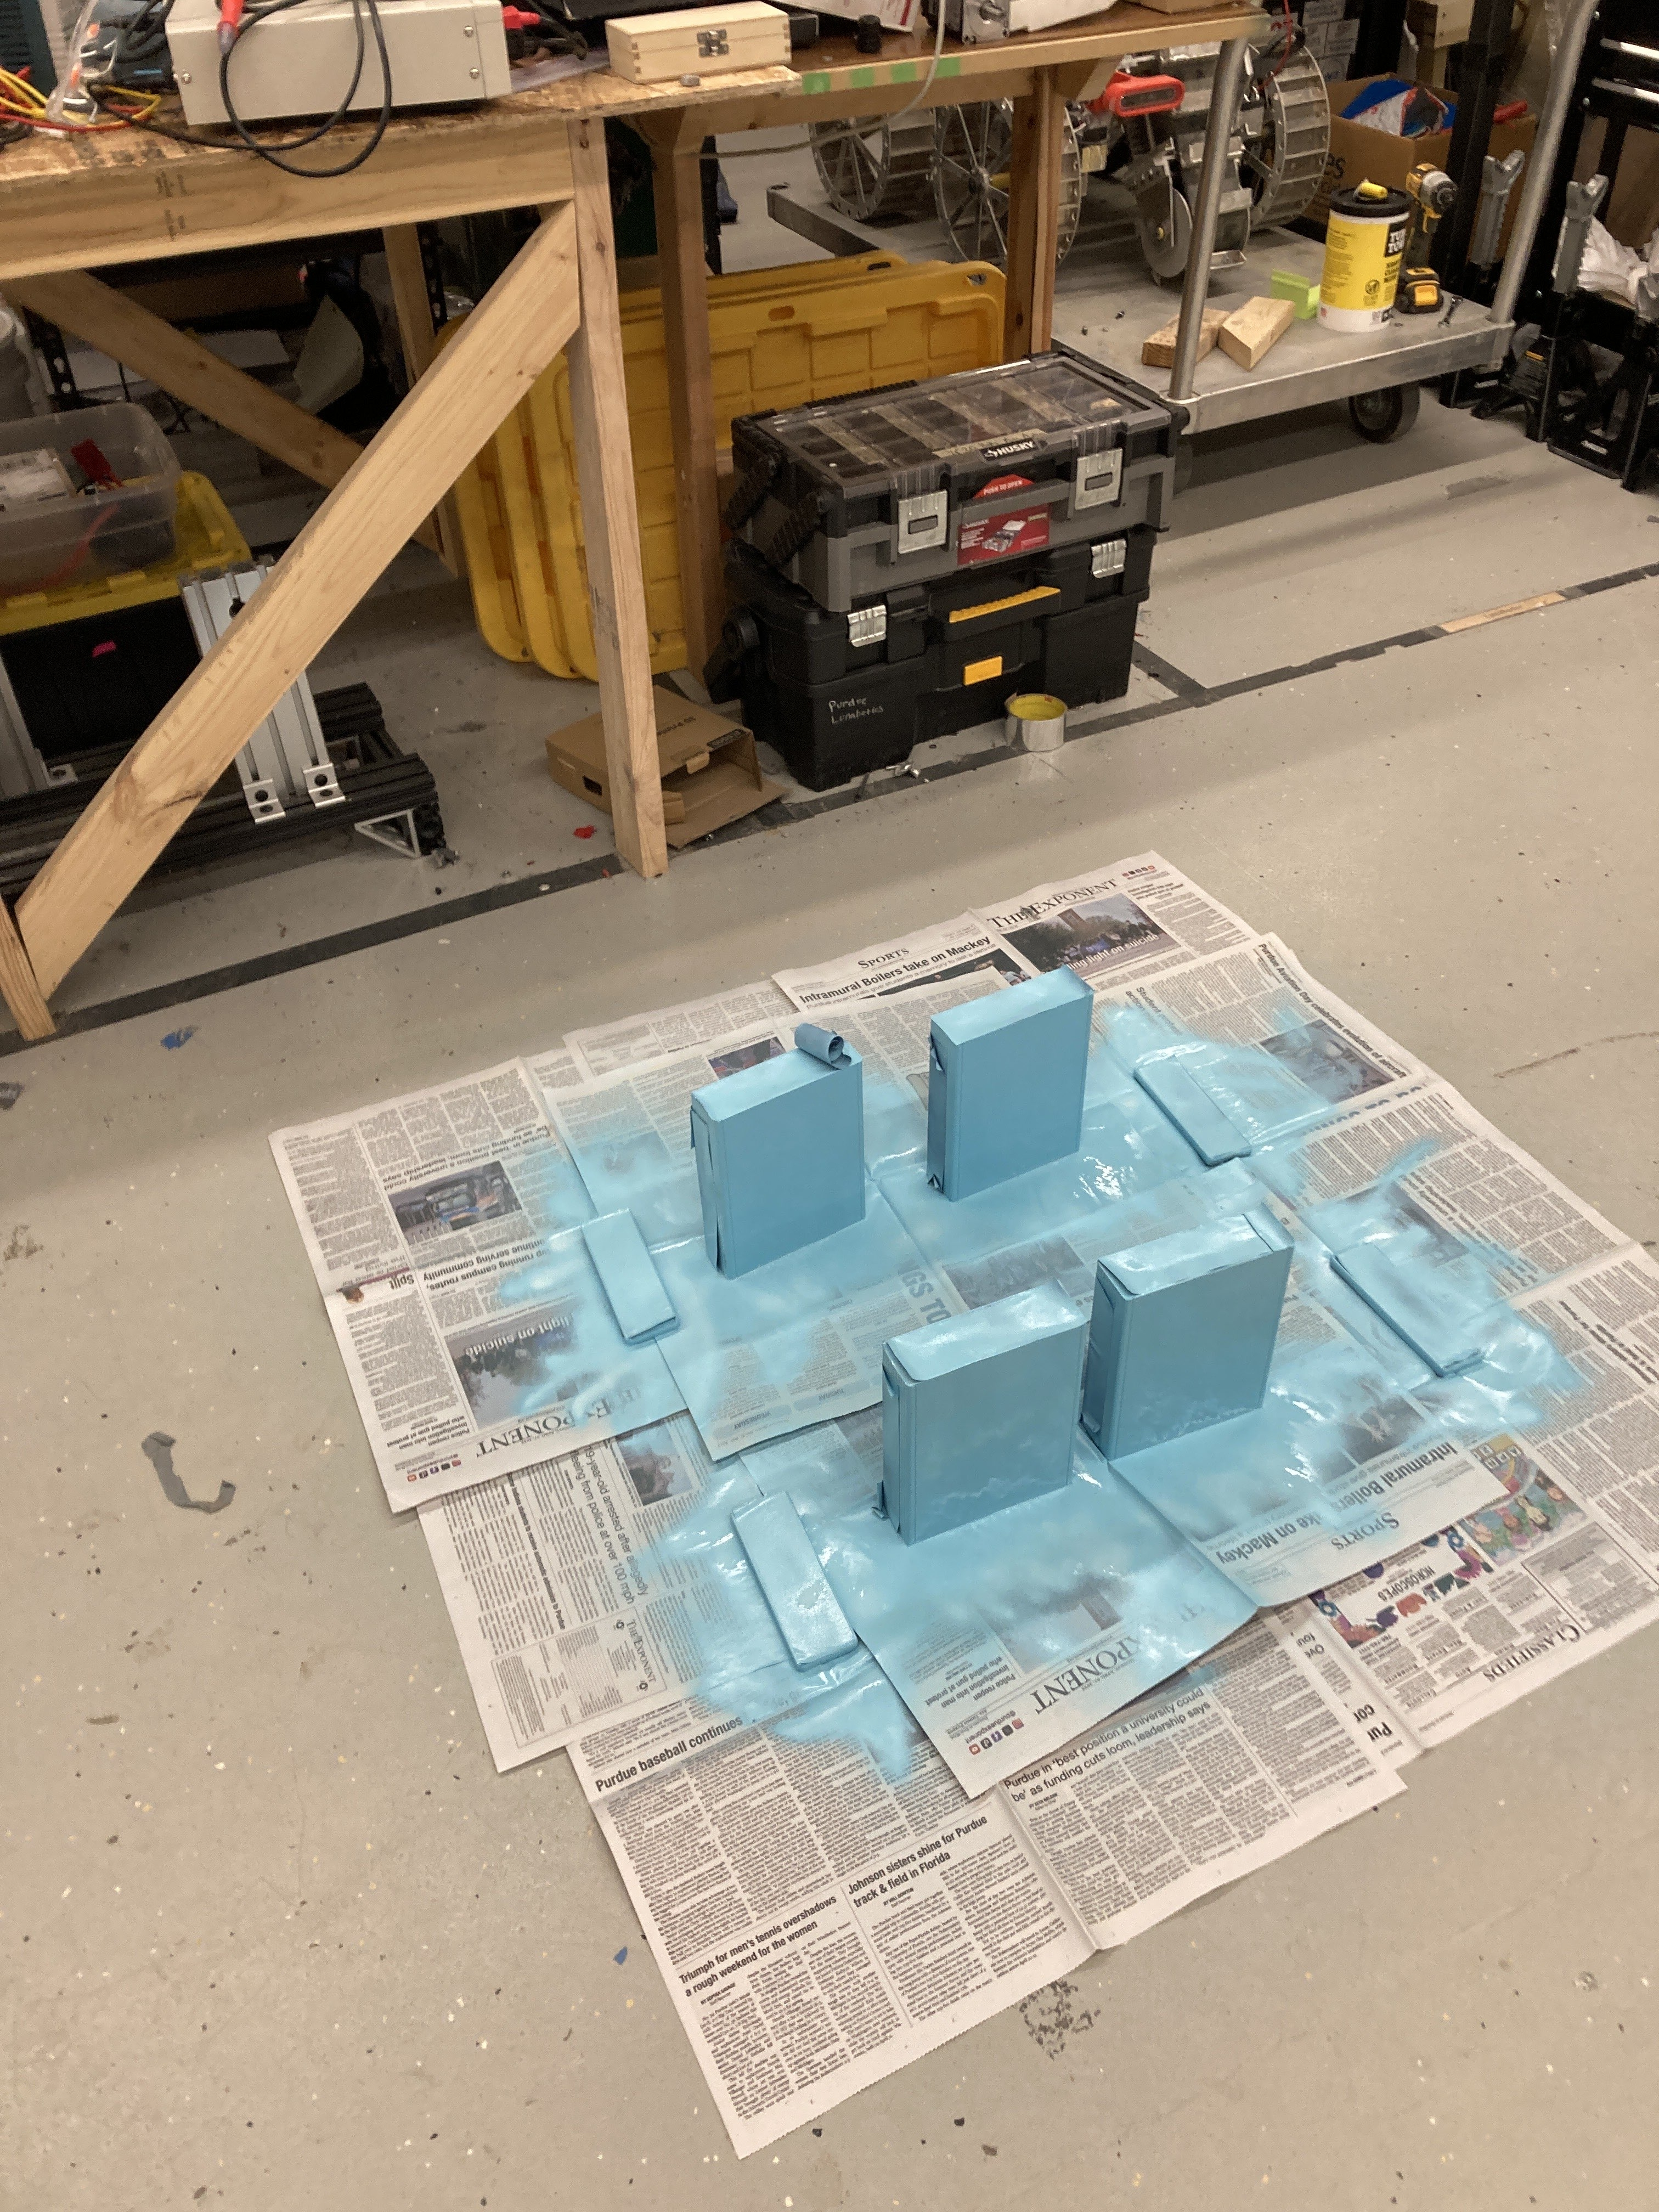
Individual contributions
Nathan Huang
Mechanical Design
Bezel CAD
Milling + Tapping Enclosures
Spray Painting

Slide 17
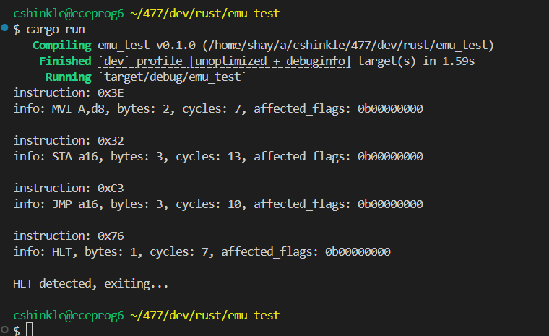
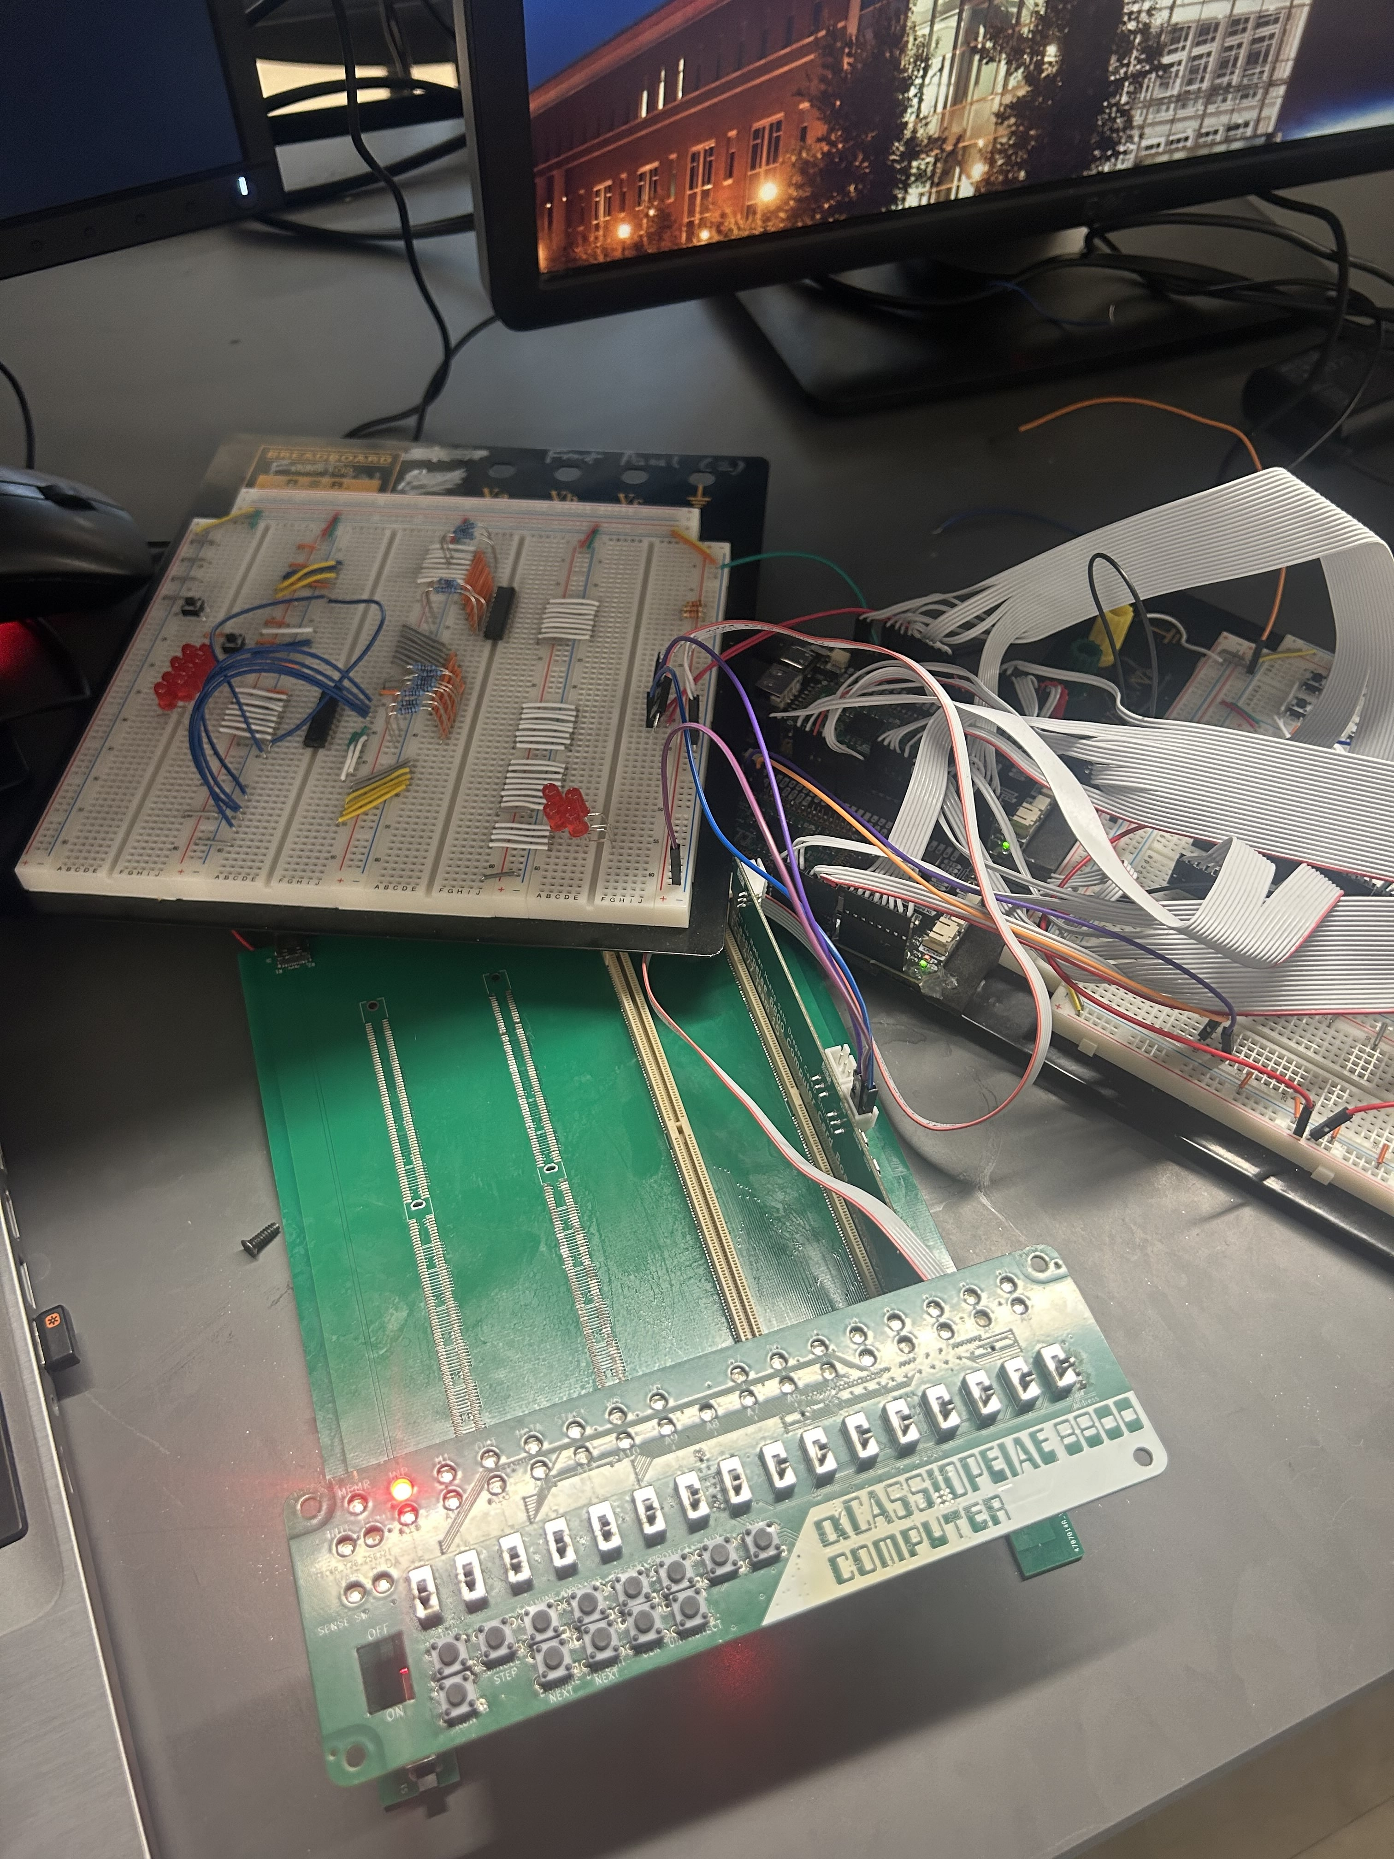
Individual contributions
Caleb Shinkle
Wrote the RAM software package, excluding bus transactions
Prototyped CPU emulator package using keyboard inputs instead of actual front panel to test instruction execution
Nearly identical to final implementation excluding main loop
Wrote the first iteration of the front panel software's main loop to run on final hardware
Integrated with simplified CPU emulator so we had something to demo
Worked on debugging main loops for front panel and CPU emulator communication

Slide 18
Project Demonstration
PSDRs
Ability to support communication between CPU and RAM cards over a simplified S-100 inspired bus, using a backplane PCB with DDR4 DIMM edge connectors to connect bus signals between cards.
An ability to interface the RP2350B microcontroller with I2C-based MCP23017 and MCP23008 I/O expanders to reduce GPIO pin usage, allowing support of all 44 bus signals and some extras that are necessary.
An ability to provide a regulated power supply is fulfilled by the backplane board, which includes a 5V to 3.3V step-down power supply using a reference buck converter design.
An ability to emulate the Intel 8080 processor in software, written in Rust to decode and execute Intel 8080 instructions with accurate cycle timing and interrupt management. This emulator will be designed to emulate 8080 machine cycles, which respect concepts such as waiting for I/O operations.
Ability to manage parallel bus data exchange using Programmable IO (PIO) assembler routines, which are assembled and processed by the CPU, RAM, and front panel software. These routines must allow for multi-device control of the same data lines on the bus.
(Stretch):
An ability for a UART card to implement the UART protocol, using I/O control lines (separate from memory control lines), and transmit and receive the information to an external UART port.

Slide 19

Project Demonstration VIDEO

Slide 20
Questions?

